Slide 1
BT201
Biochemical Process Calculations
23/08/2022

Slide 2
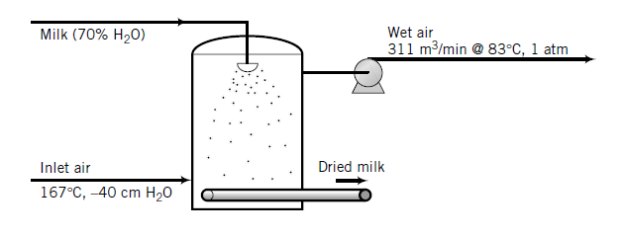
Problem 1
Spray drying is a process in which a liquid containing dissolved or suspended solids is injected into
a chamber through a spray nozzle. The resulting mist is contacted with hot air, which evaporates most or all of the liquid, leaving the dried solids to fall to a conveyor belt at the bottom of the chamber.
12 mole% water
gauge
Powdered milk is produced in a spray dryer 6 m in diameter by 6 m high. Air enters at 167 °C temperature and - 40 cm H₂O gauge pressure. The milk fed to the spray dryer contains 70% water by mass, all of which evaporates. The outlet gas contains 12 mole% water and leaves the chamber at 83 °C and 1 atm (absolute) at a rate of 311 m³/min. Assume ideal gas behavior for inlet and outlet gas streams.
Calculate the production rate of dried milk and the volumetric flow rate of the inlet air.
Estimate the upward velocity of air (m/s) at the bottom of the dryer.

Slide 3
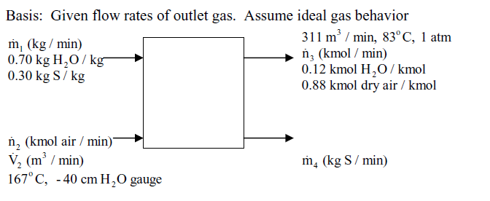
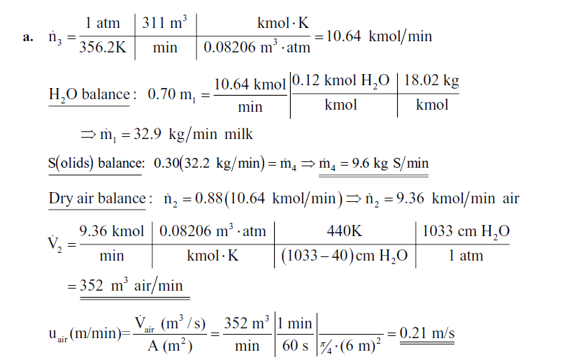
b)

Slide 4


Problem 2
Two hundred cubic centimeters of an acetone–water mixture that contains 10.0 wt% acetone is
mixed with 400.0 cm³ of chloroform at 25 °C, and the phases are then allowed to settle. What percentage
of the acetone is transferred from the water to the chloroform? Distribution coefficient of acetone in chloroform and water system is 1.72. Assume that chloroform and water are immiscible

Slide 5
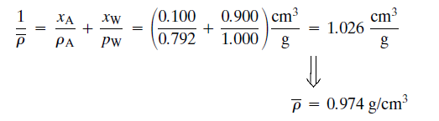
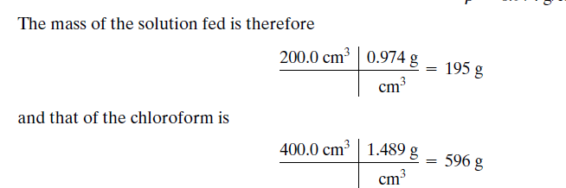
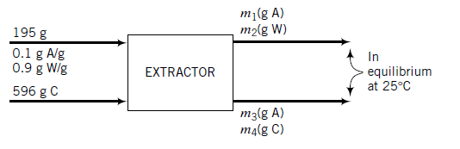

Feed:

Slide 6
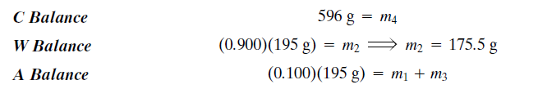

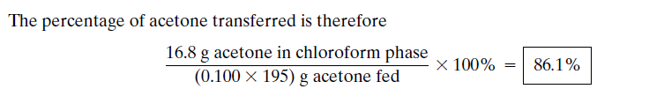
This provides one equation in the four unknowns
m1, m2, m3 ,and m4 .
The others are provided by material balances.

